Slide 1
Comprehensive Analysis of Games in the Steam Catalogue
Data Knights: Edwin Hicks, Abhishek Kumar, Ginia Chakraborti, Chinmay Katpatal, Soumith Kumar Ananthula

Slide 2
Roles
Edwin - 100% Association Rules
Abhishek - 100% Unsupervised Review (text) Analysis
Ginia - 100% Review Sentiment Analysis
Chinmay - 100% EDA
Soumith - Miscellaneous

Slide 3
Problem Definition
The Goal:
Provide data-driven insight and advice to 3 up-and-coming video game studios, relevant to the games they are developing
The Execution:
Used SteamSpy and Steam API to download available data from Steam’s entire game catalogue
Mined relevant association rules from the acquired data set
Analyzed game reviews to get feedback from users

Slide 4
Problem Motivation
The motivation is to help up-and-coming game developers who may be new to the industry, by helping them make optimal decisions to accomplish their goals.
Here our target developers are not industry giants like EA, Bethesda, Activision, or Rockstar. Our target developers are smaller game studios who have less resources available to them, looking for an edge in a crowded market.

Slide 5
Totally Real Studios - Emerald Sky
Genre: Action-Adventure
Number of Players: Single-player
Written Language: English
Supported Languages: Spanish
Price: $19.99
Relevant Tags: Survival, Realistic, Exploration
Goal: At least a 75% positive review score

Slide 6
Lungfish Studios - Atomic Brain
Genre: RPG
Number of Players: Single-player / Co-op
Written Language: Japanese
Supported Languages:
Price: $29.99
Relevant Tags: Futuristic, Sci-Fi, Turn-Based
Goal: Owned by as many users as possible

Slide 7
Two Point Two Studios - Skyfall
Genre: Battle Royale
Number of Players: Multiplayer
Written Language: English
Supported Languages: Spanish, Russian, Chinese, Japanese, Korean
Price: $59.99
Relevant Tags: Battle-Royale, PvP, Third-Person Shooter
Goal: Highest concurrent daily players as possible

Slide 8
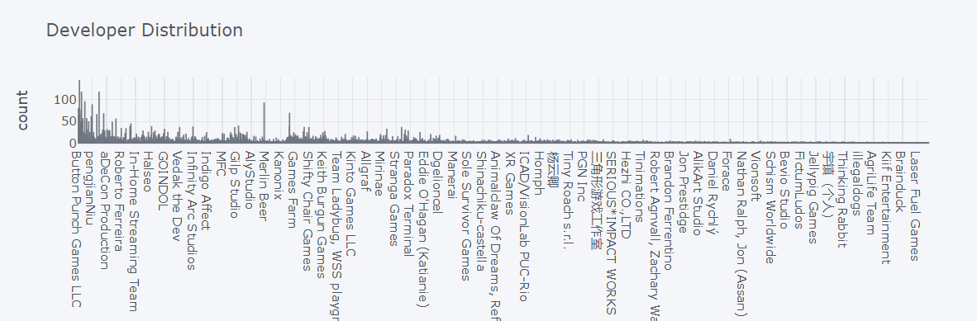
EDA
Developers vs No. of games developed respectively

Slide 9
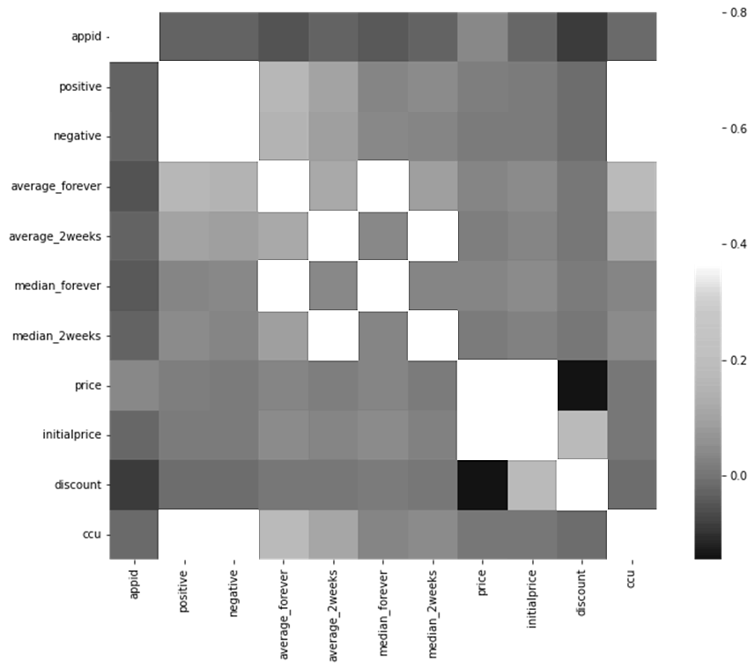
Correlation Matrix

Slide 10
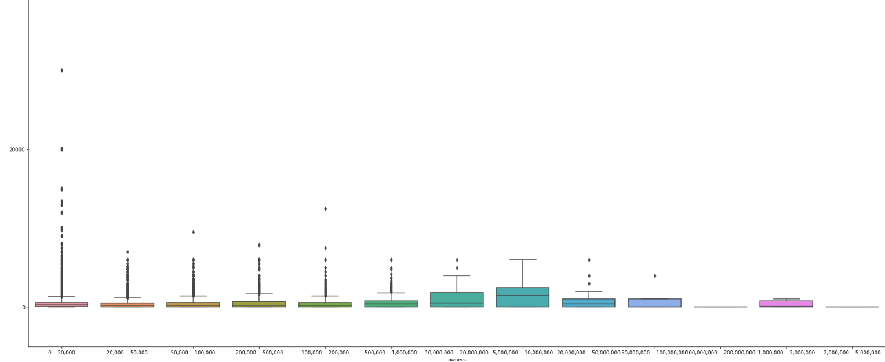
Most games are well below 20000 price tag as there appears to be some outliers which have prices over 35000. Below plot shows us the number of owners against the cost of the game.

Slide 11
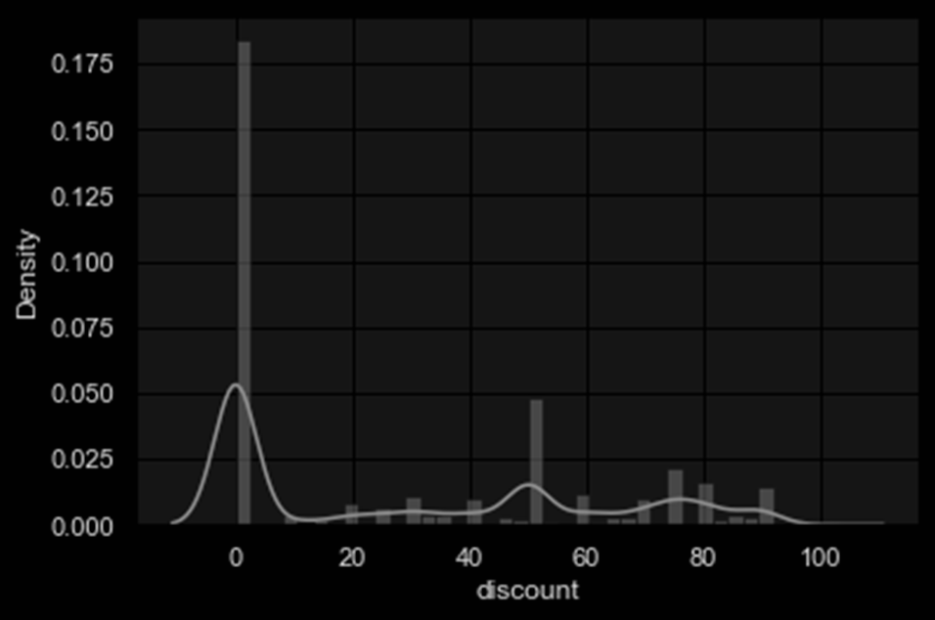
Here we can see what discount percentage is given the most, as the trends and data suggest 0 percent discount is highest between games on Steam.
50 % discount being the second highest and so on.

Slide 12
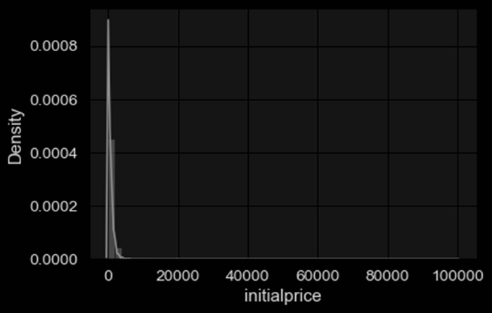
This further proves the point of most games being well below 20000 price tag.

Slide 13
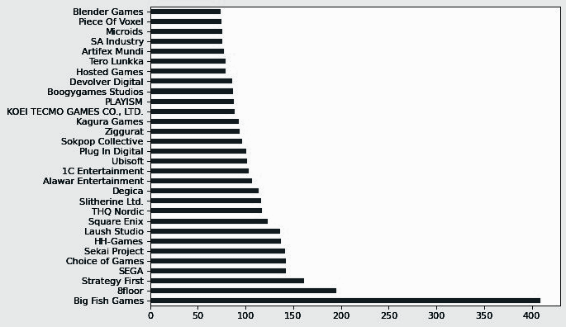
Big Fish Games has the most no. of games published followed by 8floor according to the data.

Slide 14
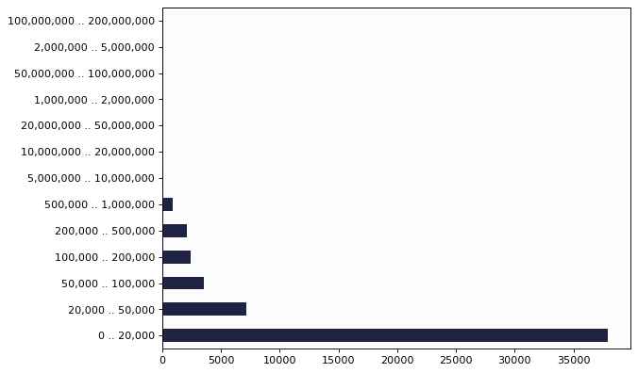
Here we can see that most number of games have 0 to 20000 owners, as the most played games are constant they are usually in single digits like CS:GO, Dota etc. These games have over 10 million owners.

Slide 15
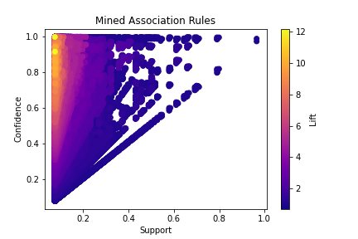
Association Rules
488,214 rules total
12,744 unique itemsets
There are no helpful hard-and-fast rules, only deterministic ones

Slide 16
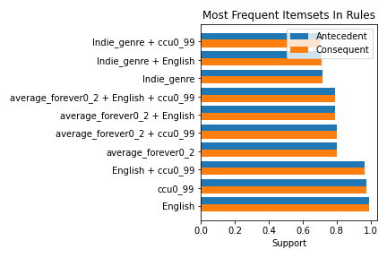
Most Frequent Itemsets In Generated Rules
The most frequent itemsets are the same for both the antecedents and consequents, and they have the same support
These are the most important items and itemsets

Slide 17
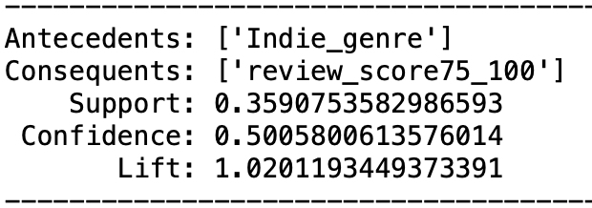
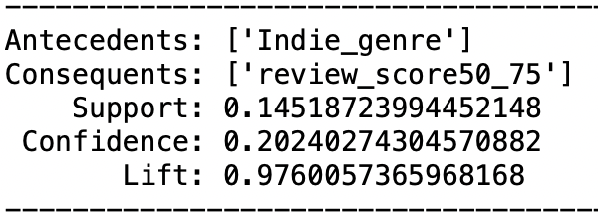
Indie Games and Review Scores
9937 rules with Indie genre as an antecedent and a review score above 75% as a consequent
261 rules with Indie genre as an antecedent and a review score between 50% and 75% as a consequent
Indie games, when reviewed, are scored higher rather than lower

Slide 18
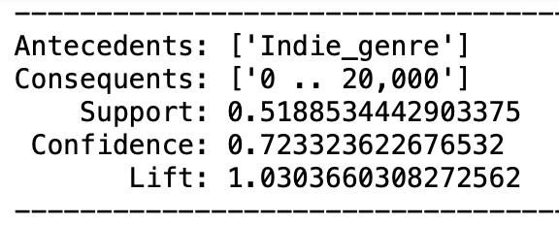
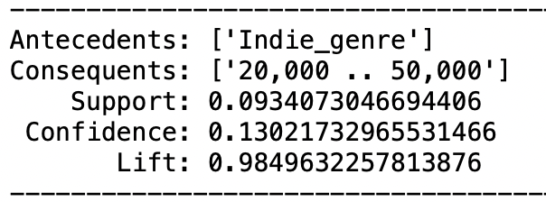
Indie Games and Owner Count
30,011 rules with Indie genre as an antecedent and less than 20,000 owners as a consequent
27 rules with Indie genre as an antecedent and 20,000 to 50,000 owners as a consequent
Indie games will most likely have less than 20,000 owners

Slide 19
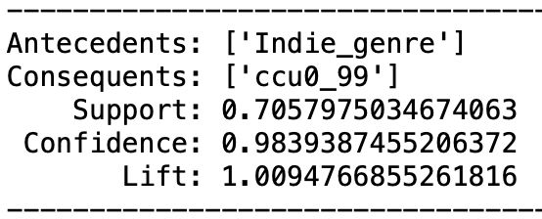
Indie Games and Concurrent Daily Players
41,347 rules with Indie genre as an antecedent and less than 99 daily players as a consequent
Indie games will very likely have less than 99 daily players

Slide 20
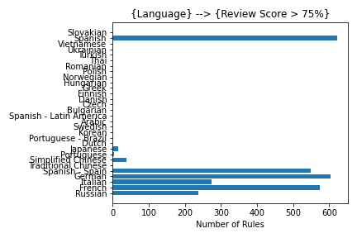
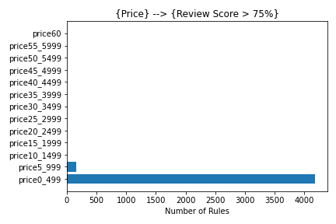
Other Interesting Plots

Slide 21
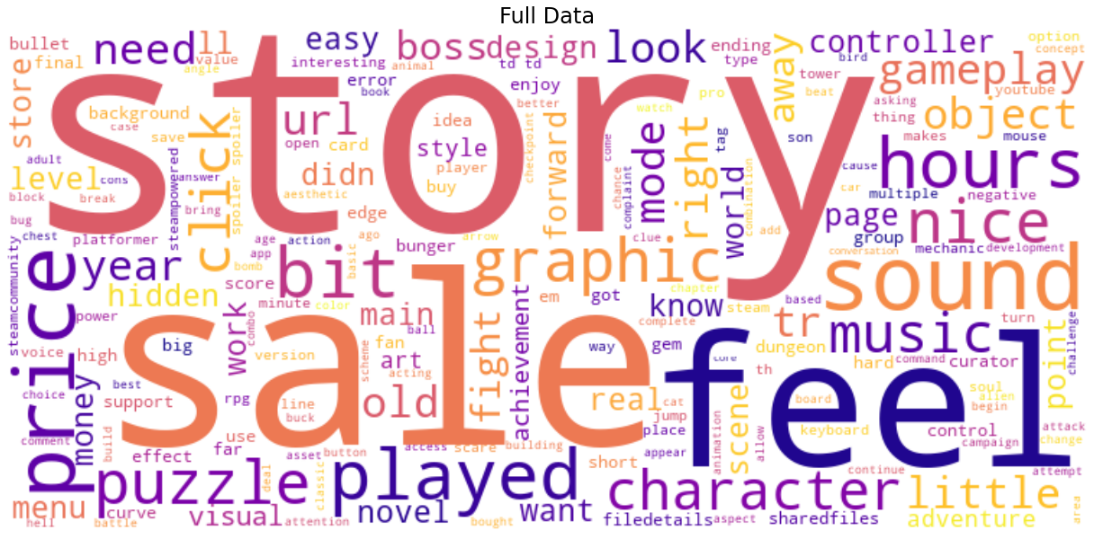
Text Analysis - Unsupervised - Word Cloud - All reviews
Notes:
Story is clearly the most important, followed by ‘sale’ (price consciousness) and feel
‘Pretty’: … be pretty decent …, … pretty fun …
‘Worth’: … not worth it …, … worth the hype …
‘Hour’: only 14 reviews

Slide 22
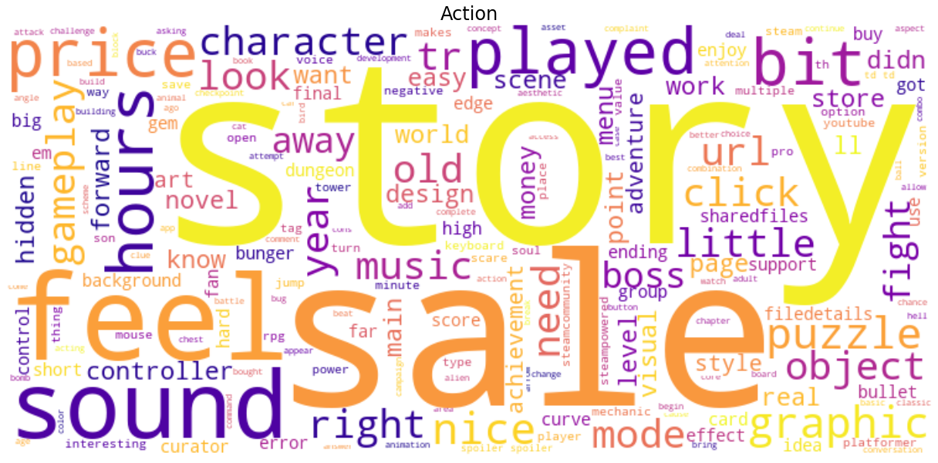
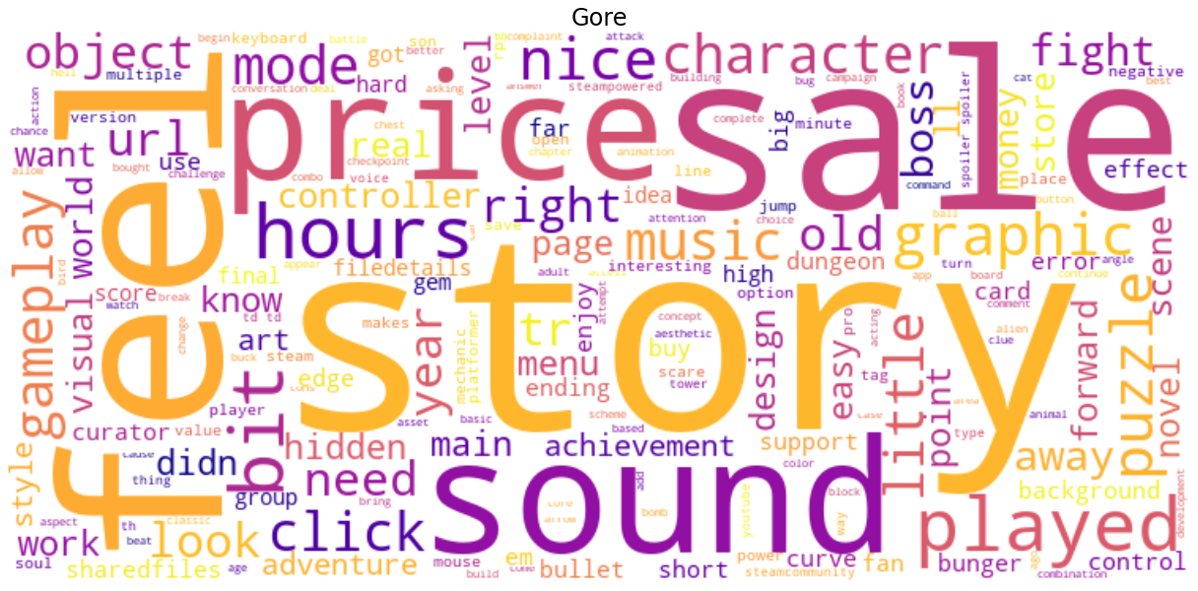
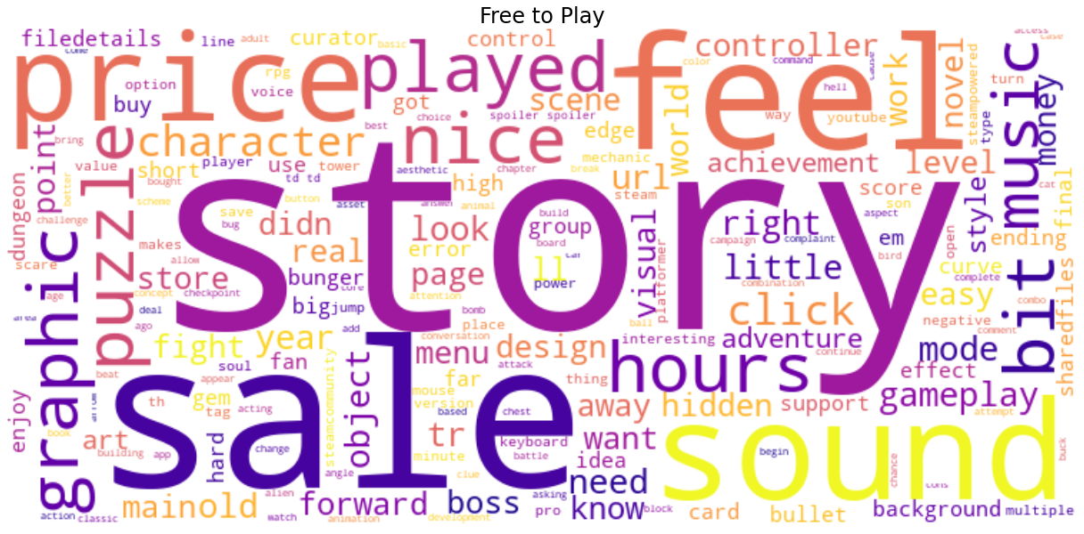
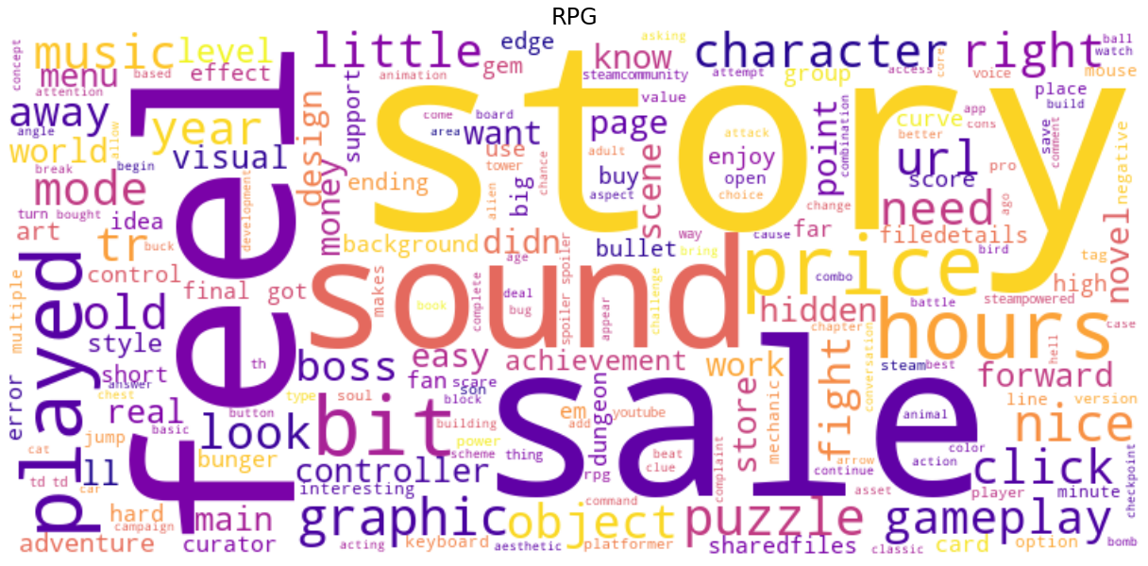
Text Analysis - Unsupervised - Word Cloud - Specific Genres
Notes:
Across genres - ‘story’, ‘sale’, ‘feel’, sometimes ‘sound’ and others like ‘graphic’
Even in FTP - does it mean FTPs are not truly FTPs?

Slide 23
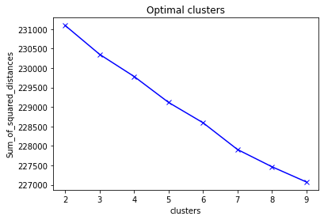
Text Analysis - Unsupervised - Clustering
Cluster 0
cool, simple, price, better, little, just, played, best, buy, love
Cluster 1
nice graphics, short, like, story, puzzle, music, graphics, little, nice little, nice
Cluster 2
think, gameplay, bit, feel, little, way, level, story, just, like
Notes:
Across genres - ‘story’, ‘sale’, ‘feel’, sometimes ‘sound’ and others like ‘graphic’
Even in FTP - does it mean FTPs are not truly FTPs?

Slide 24
Text Analysis - Unsupervised - Clustering
Cluster 0 - Review 0: i ran into a bug where a house construction never ended and i don't like this type of game enough to power through it.
Cluster 0 - Review 1: a sweet little tycoon / transport game!
super super fun to play!
Cluster 1 - Review 0: nice addictive and competitive mini-games, it's good to play for improve your score
it may be good to have a system of success and rewards
Cluster 1 - Review 1: wish it was easier to obtain this at launch but still a nice benefit to have rather than being locked to the game as a dlc.
Cluster 2 - Review 0: [h1]buy and play this before soko loco deluxe. it's an astonishingly good game for this price point.[/h1]
soko loco falls into a subgenre that i'll call railroad-lites: railway management games that have goal-driven gameplay like railroad tycoon without the massive web of variables that require dozens (if not hundreds) of hours of gameplay to fully appreciate. of the games in its subgenre, it does the best job - even better than its deluxe version - of making you feel as if you are physically picking up and placing individual pieces of railroad track on the terrain.
Notes:
Cluster 0: Slightly vague
Cluster 1: Reviews more detailed in terms of gameplay or graphics
Cluster 2: Technical reviews with technical terms written by expert players

Slide 25
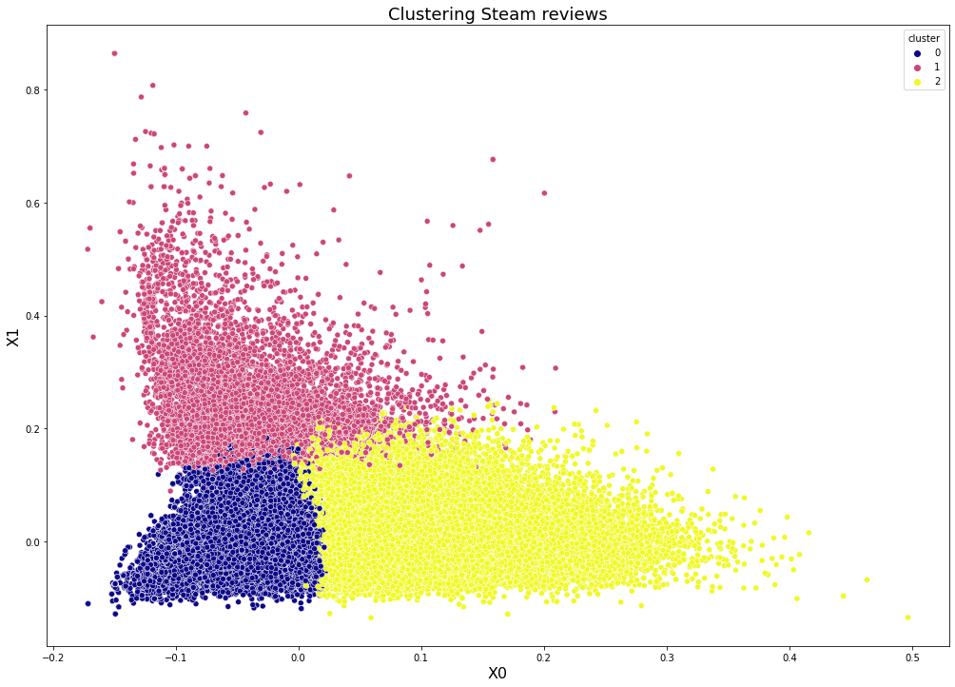
Text Analysis - Unsupervised - Clustering

Slide 26
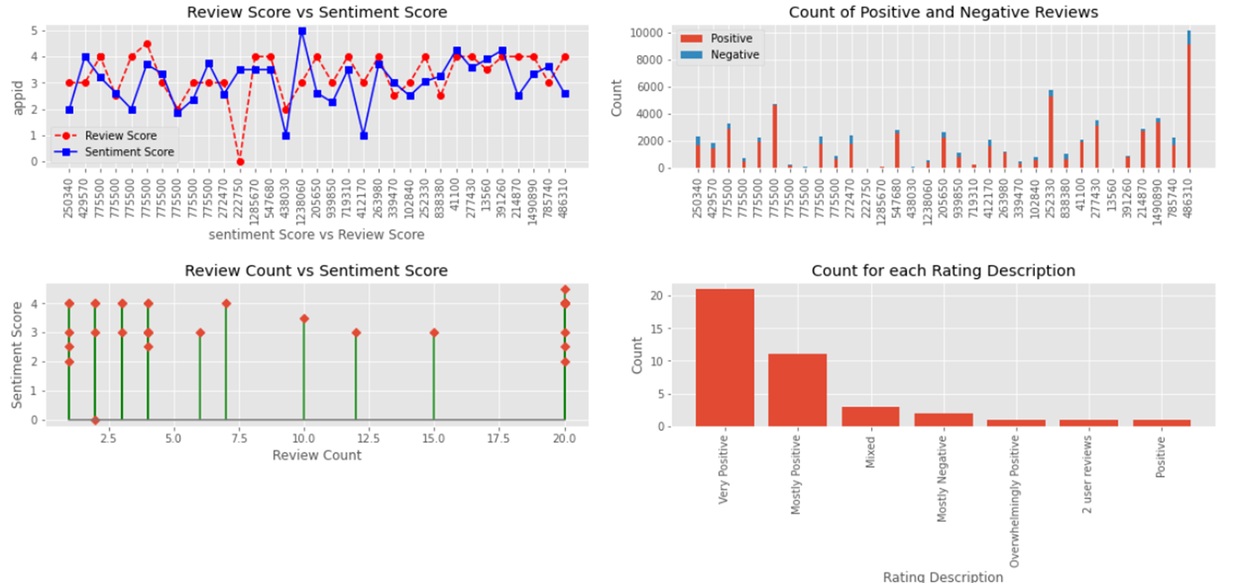
Sentiment Analysis - Dashboard

Slide 27
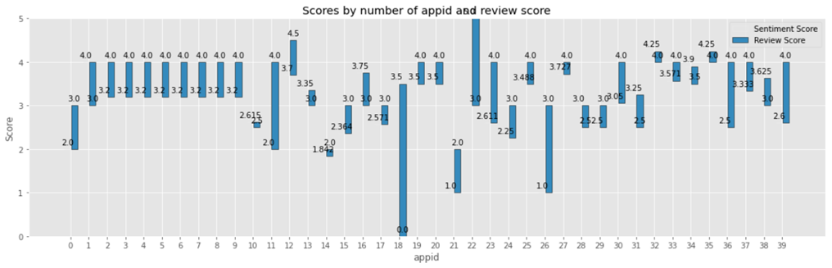
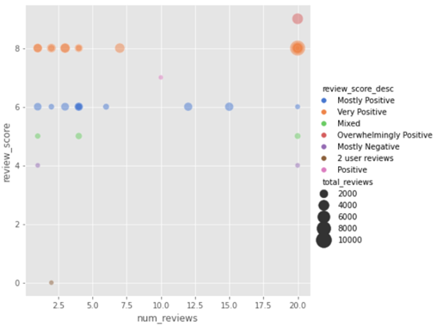
Sentiment Analysis – Dashboard(contd.)

